Slide 2
Azure Cosmos DB Overview
Rafat Sarosh
Principal Program Manager – Azure Cosmos DB
@rafatsarosh
Notes:
{Opening greeting}

Slide 3
Modern apps face new challenges
Managing and syncing data distributed around the globe
Delivering highly-responsive, real-time personalization
Processing and analyzing large, complex data
Scaling both throughput and storage based on global demand
Offering low-latency to global users
Modernizing existing apps and data –
Personalization, Recommendation, Social, Gamification.
Notes:
Before we talk about CosmosDB, lets quickly see what problems we are trying to solve. What are the challenges faced by modern apps.
1. World is truly flat – All applications are global in nature. Data is no more produced and consumed by one region but generally it is all distributed across globe.
2. Personalization is no more premium feature. It is a given, it is min bar. And it must be blazing fast.
3. Because of personalization and recommendation you need to process large amount of data. I am talking about data in TB and PB.
4. Because of global nature of applications, it is very difficult to predict storage and throughput requirement. We need to have auto scale for both storage and thoughtput
5. With scalability we must maintain low-latency. Anything higher 500 ms is too slow, generally web services should respond with 100-150 ms.
6. In last modern apps must have Personalization, recommendation, social, gamification –
Microsoft was envisioning these challenges sometime around 2010 for their own application. We needed data store for Xbox, AD, Azure, MSN, Skype (2011)

Slide 4
Azure Cosmos db
A FULLY-MANAGED MULTI MODEL, MULTI MASTER, GLOBALLY DISTRIBUTED DATABASE SERVICE BUILT TO GUARANTEE
EXTREMELY LOW LATENCY AND MASSIVE SCALE FOR MODERN APPS
Notes:
This brings us to Azure Cosmos DB
A FULLY-MANAGED - MULTI-MODEL - GLOBALLY DISTRIBUTED DATABASE SERVICE - For LOW LATENCY AND High throughput – A Database which is born in cloud

Slide 5



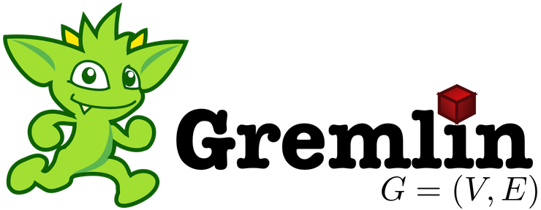

SQL
mongoDB
Azure Cosmos DB
… more coming soon
Key-Value
Column-family
Documents
Graph
Global distribution
Elastic scale out
Guaranteed low latency
Five consistency models
Comprehensive SLAs
A globally-distributed, multi-model, database service
Notes:
Because It is a database born in cloud - fundamental design goals since the inception - Automatic Global distribution – Limitless scale – Low Latency – High throughput – and Well defined consistency model – with 5’9’s SLA
So we Built the platform with these Core Capability.
And as a developer you also want the flexibility. With Azure Cosmos DB, you don’t have to model the data in JUST one way. You can model the data the way you want.
Key-Value, Column, Documents or Graph.
That’s why say Cosmos DB is a multi-model database.
What about how you access data. What about frameworks, API and tools that you are familiar with.
We do not want you yo learn a new API. We make every API and language a first-c;ass citizen of Azure Cosmos DB. If you are familiar with DocumentDB SQL or DocumentDB JS, we continue to support and innovate on that front. If you are a MongoDB developer, we have support for MongoDB wire protocol. Azure Cosmos DB can be your globally distributed, secure, fully managed Mongo Instance. Today, we announced preview of Azure Tables API and Gremlin for graph capabilities. We have more in the works and our roadmap is to extend this over the coming months to include Hbase, Cassandra and other OSS API.

Slide 6
Turnkey global distribution
PUT YOUR DATA WHERE YOUR USERS ARE IN MINUTES
Automatically replicate all your data around the world, and across more regions than Amazon and Google combined.
Available in all Azure regions
Manual and automatic failover
Automatic & synchronous multi-region replication
Notes:
Ring 0 Service.
More Data Center than Amazon and Google Combined

Slide 7
ELASTIC SCALE OUT OF STORAGE AND THROUGHPUT
SCALES AS YOUR APPS’ NEEDS CHANGE
Independently and elastically scale storage and throughput across regions – even during unpredictable traffic bursts – with a database that adapts to your app’s needs.
Elastically scale throughput from 10 to 100s of millions of requests/sec across multiple regions
Support for requests/sec for different workloads
Pay only for the throughput and storage you need
Notes:
RU is the Cosmos DB Currency

Slide 8
GUARANTEED LOW LATENCY
PROVIDE USERS AROUND THE WORLD WITH FAST ACCESS TO DATA
Serve <10 ms read and <15 ms write requests at the 99th percentile from the region nearest to users, while delivering data globally.
Notes:
Single digit latency -> SLA

Slide 9
FIVE WELL-DEFINED CONSISTENCY MODELS
CHOOSE THE BEST CONSISTENCY MODEL FOR YOUR APP
Offers five consistency models
Provides control over performance-consistency tradeoffs, backed by comprehensive SLAs.
An intuitive programming model offering low latency and high availability for your planet-scale app.
Strong
Bounded-stateless
Session
Consistent prefix
Eventual
Notes:
Tunable Consistency -> Single digit latency
Bounded Staleness - Consistent Prefix. Reads lag behind writes by k prefixes or t interval
Session - Consistent Prefix. Monotonic reads, monotonic writes, read-your-writes, write-follows-reads
Consistent Prefix - Updates returned are some prefix of all the updates, with no gaps

Slide 10



Multiple data models and apis
USE THE MODEL THAT FITS YOUR REQUIREMENTS, AND THE APIS, TOOLS, AND FRAMEWORKS YOU PREFER
Cosmos DB offers a multitude of APIs to access and query data including, SQL, various popular OSS APIs, and native support for NoSQL workloads.
Use key-value, tabular, graph, and document data
Data is automatically indexed, with no schema or secondary indexes required
Blazing fast queries with no lag
Table API
MongoDB
SQL
Column-family
Document
Key-value
Graph
Notes:
Multi – Model -> Elastic Scale out
No need to convert you data to meet any particular model

Slide 11
COMPREHENSIVE SLAs
RUN YOUR APP ON WORLD-CLASS INFRASTRUCTURE
Azure Cosmos DB is the only service with financially-backed SLAs for millisecond latency at the 99th percentile, 99.999% HA and guaranteed throughput and consistency
Latency
HA
Throughput
Consistency
<10 ms
99.999%
Guaranteed
Guaranteed
99th percentile
Notes:
HA 99.999% for multi-region read; 99.99% for single region deployments

Slide 12
Trust your data to industry-leading Security & Compliance
Azure is the world’s most trusted cloud, with more certifications than any other cloud provider.
Enterprise grade security
Encryption at Rest
Encryption is enabled automatically by default
Comprehensive Azure compliance certification
Notes:
Encryption at Rest
Always encrypted at rest and in motion
Data, index, backups, and attachments encrypted
Encryption is enabled automatically by default
No impact on performance, throughput or availability
Transparent to your application
Comprehensive Azure compliance certification
ISO 27001, ISO 27018, EUMC, HIPAA, PCI
SOC1 and SOC2 (Audit complete, Certification in Q2 2017)
FedRAMP, IRS 1075, UK Official (IL2) (Q2 2017)
HITRUST (H2 2017)

Slide 13
Top 10 reasons why customers use Azure Cosmos DB
The 1st and only database with global distribution turnkey capability
Deliver massive storage/throughput scalability database
Provides guaranteed single digit millisecond latency at 99th percentile worldwide
Natively supports different types of data at massive scale
Boasts 5 well-defined consistency models to pick the right consistency/latency/ throughput tradeoff
Enables mission critical intelligent applications
Gives high flexibility to optimize for speed and cost
Tackles big data workloads with high availability and reliability
Provides multi-tenancy and enterprise-grade security
Naturally analytics-ready and perfect for event-driven architectures
Notes:
Azure Echo system

Slide 14



















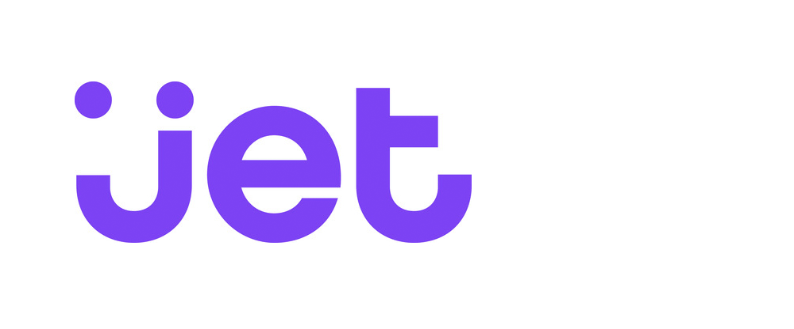

































Customers powering their Apps with Azure Cosmos DB
7000+ Azure Cosmos DB customers
NoSQL is growing at 35.1% YoY
20% of customers have migrated Apps from Mongo DB to Cosmos DB
Notes:
Why is Microsoft investing $5B in IoT? More than 90 percent of the Fortune 500 has selected Microsoft as a partner and trusted provider of cloud platform and services.
Many companies including Kohler, The Hershey Company, Schneider Electric, Steelcase, and ThyssenKrupp have already selected Microsoft Azure as their platform of choice to innovate in IoT, and at the edge where devices are powerful enough to run AI and ML without “always on” dependencies on the cloud. By investing even more in IoT, Microsoft is committing the resources and innovation to empower companies to take advantage of IoT and the intelligent edge.

Slide 15

Cosmos DB wins 2018 Technology of the Year Awards
“Do you need a distributed NoSQL database with a choice of APIs and consistency models? That would be Microsoft’s Azure Cosmos DB.”—InfoWorld, Technology of the Year 2018: The best hardware, software, and cloud services
Notes:
Third year in a row Gartner has positioned Microsoft as a Leader in the 2017 Magic Quadrant for Operational Database Management Systems.
60% of this score is customers and more than 50% who responded were Cosmos DB customers.
https://db-engines.com/en/ranking
You can see the hockey stick growth with DB engines
We are number one in multi-model, second in Graph, third in key value and wide column, and 5th in document.

Slide 16
Q & A
Notes:
Speaker Notes:
Just like how customer experience have become critical to the success , your customers expectations have also increase
Your customers have really high expectations.
1) They want to know them and be aware of their context and needs, make it easy to engage with your business whether they are looking to learn more about a product or service or buying from you. And do so in a way that is consistent where they are experiencing your business whether they are home at work on the go. And they want an experience that is fast - milliseconds not minutes is the new measure of wait times.
and fast
References:
https://www.glassboxdigital.com/
2) Accenture Global Consumer Pulse 2013
3) https://blog.kissmetrics.com/speed-is-a-killer/
4) 29% said they are were less likely to buy products if they receive irrelevant marketing (1)
Janrain and Blue Research (http://janrain.com/about/newsroom/press-releases/national-study-shows-consumers-abandon-brands-online-out-of-frustration-with-mistargeting/)
http://www.huffingtonpost.com/entry/dont-let-irrelevant-messaging-cause-your-customers_us_584eddf9e4b0151082221db6

Slide 17
Change Feed

Slide 18
Change Feed
Persistent log of records within an Azure Cosmos DB container.
Documents presented in the order in which they were modified
New Events
Azure Cosmos DB
Change feed

Slide 19


Change Feed Scenarios
Event Computing and Notifications
Retail, Gaming, Content management
Trigger a call to an API when a document is inserted or modified
Azure functions
Azure Notification Hubs
Azure App Service
Stream Processing
IoT Processing, Data Science & Analytics
Perform real-time (stream) processing on updates to data
New Events
Azure Stream Analytics
Azure HDInsight
Apache Spark
Apache Storm
Azure Cosmos DB
Change feed
Data movement
Enterprise Data Management
Move, clone, or archive data to cold storage
Azure Storage Blob
Azure Data Lake
Azure Cosmos DB

Slide 20
Event Sourcing for Microservices
Trigger Action From Change Feed
Persistent Event Store
Microservice #1
New Event
Microservice #2
…
Azure Cosmos DB
Change feed
Microservice #N
Notes:
Event Sourcing
Micro-services

Slide 21
Materializing Views
Application
Azure Cosmos DB
Materialized View
Subscription | User | Create Date | …
123abc | Ben6 | 6/17/17
456efg | Ben6 | 3/14/17
789hij | Jen4 | 8/1/16
012klm | Joe3 | 3/4/17
User | Total Subscriptions
Ben6 | 2
Jen4 | 1
Joe3 | 1
Change feed
Notes:
Materialized view
Spark

Slide 22
Replicating Data
Secondary Datastore (e.g. archive)
Replicated Records
CRUD Data
Azure Cosmos DB
Change feed
Notes:
Data Migration
Now lets look at the event sourcing pattern

Slide 23
Q & A
Notes:
Speaker Notes:
Just like how customer experience have become critical to the success , your customers expectations have also increase
Your customers have really high expectations.
1) They want to know them and be aware of their context and needs, make it easy to engage with your business whether they are looking to learn more about a product or service or buying from you. And do so in a way that is consistent where they are experiencing your business whether they are home at work on the go. And they want an experience that is fast - milliseconds not minutes is the new measure of wait times.
and fast
References:
https://www.glassboxdigital.com/
2) Accenture Global Consumer Pulse 2013
3) https://blog.kissmetrics.com/speed-is-a-killer/
4) 29% said they are were less likely to buy products if they receive irrelevant marketing (1)
Janrain and Blue Research (http://janrain.com/about/newsroom/press-releases/national-study-shows-consumers-abandon-brands-online-out-of-frustration-with-mistargeting/)
http://www.huffingtonpost.com/entry/dont-let-irrelevant-messaging-cause-your-customers_us_584eddf9e4b0151082221db6

